Slide 1
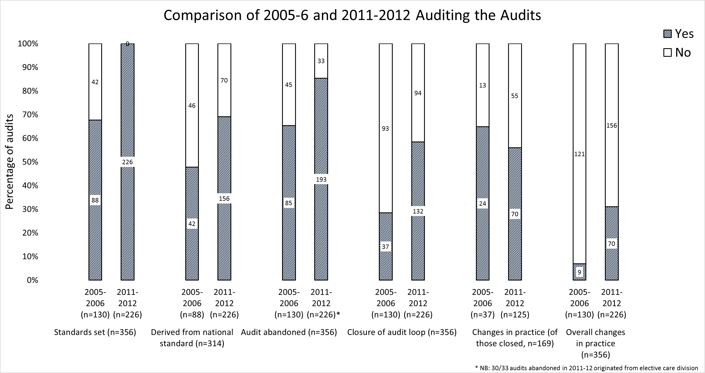
Improving practice across a Foundation Trust
Audit of Audits
Dr Tom Wingfield, Dr Mohammed Akuji, Michelle Warner
BACKGROUND
Audit and clinical governance aim to improve delivery of health services and optimise patient care. With
increasingly limited resources, the efficiency by which the audit process is undertaken is fundamental to
maintaining continuous quality improvement. We reviewed the effectiveness of the audit process in our
NHS foundation trust by completing an audit of the audits.
METHOD
In 2008, 130 audits submitted between March 2005 and March 2006 were retrospectively reviewed using a locally-piloted audit assessment tool. Two major changes in the way the department processed all audits were implemented: 1) An electronic audit registration database was set up for better control and monitoring; 2) A strict audit registration process was implemented with requisites including measuring practice against clear recognised standards and having a named supervising consultant with ultimate responsibility for audit completion. In 2013, to complete the audit cycle, 226 audits submitted between April 2011 and April 2012 were further reviewed. Statistical comparison was performed using the z test of proportions.
FINDINGS
Comparing 2011-2012 to 2005-2006, the following improvements were noted: an increase in submitted audits measuring against recognized standards mainly from national guidance (68% [95%CI=60-76] versus 100%, p<0.0001); a decrease in abandonment rate (65% [95%CI=57-73] versus 15% [95%CI=10-20], p<0.0001); an increase in audit loop closure (28% [95%CI=20-35] versus 58% [95%CI=52-64], p<0.0001); and a significant increase in the number of audits leading to a measurable change in practice within the trust (7% [95%CI=3-11] versus 31% [95%CI=25-37], p<0.0001).
IMPROVED
IMPROVED
IMPROVED
IMPROVED
SIMILAR
IMPROVED
CONCLUSIONS
Despite an increasing caseload, implementation of a simple yet robust audit registration and monitoring system by our department was associated with a significant improvement in the standard, completion and outcome of audits. Such improvements led to increased measurable changes in practice within our trust. We feel other healthcare trusts could benefit by replicating the changes made by our clinical effectiveness department.
Contacts: mohammed.akuji@nhs.net

