Slide 1
Agents for Change in partnership with
Faculty of Medical Leadership
and Management (FMLM)
What junior doctors need to know about interactions with industry, transparency, and competing interests
Dr Emma Parish, Dr Abigail Moore & Dr Kate Adlington
National Medical Director’s Clinical Fellows
Tuesday 21st July 2015
Notes:
Agents for Change: What junior doctors need to know about interactions with industry, transparency, and competing interests

Slide 2
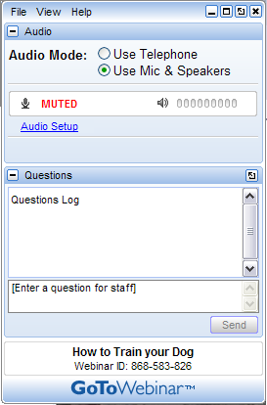
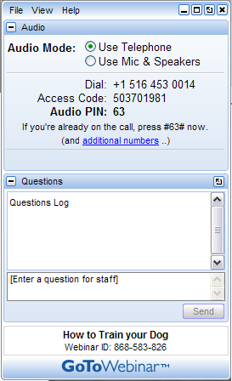
GoToWebinar Attendee Interface
1. Viewer Window
2. Control Panel

Slide 3
Declaration of interests
Kate Adlington – National Medical Director’s Clinical Fellow (BMJ/ NHS England) and core medical trainee. Member of BMJ-led working group considering mechanisms for declaration of doctors’ interests.
Emma Parish – National Medical Director’s Clinical Fellow (Editorial Registrar, the BMJ) and paediatric trainee out of programme.
Abigail Moore – National Medical Director’s Clinical Fellow (RCP) and respiratory registrar out of programme. Member of BMJ-led working group considering mechanisms for declaration of doctors’ interests.
Notes:
Commitment increasing in various parts of the NHS system, Coalition Government’s vision for the reform of the health service reinforces the importance of medical leadership and the engagement of doctors in leading commissioning and service improvement at all levels. High Quality Care for All Final Report, Doctors in Society: medical professionalism in a changing world (2005) by the Royal College of Physicians (London) has provided an important contribution to the debate on the changing nature of the medical profession.
EEML Project – joint AoMRC and NHS Institute, aim to promote medical leadership and help create organisational cultures where doctors seek to be more engaged in management and leadership of health services and non-medical leaders genuinely seek their involvement to improve services for patients across the UK. MLCF key product.
This is now incorporated into training and educational curricula at both undergraduate and postgraduate levels with supporting e-learning materials particularly for the latter. In this context Colleges and other relevant interest groups have been engaging for some time on how standards in the area can be defined and maintained and particularly how the medical profession can take greater ownership of this agenda.
Working group established as result and a paper submitted to Academy Council which was endorsed
.

Slide 4
Key objectives
This webinar will discuss:
What is a competing interest?
Why should junior doctors know about this?
How can junior doctors promote transparency?
How should junior doctors declare their competing interests?
How to make use of opportunities and still future-proof your career?

Slide 5
Poll
Do you think you have any competing interests or interactions with industry that you might need to declare?
Yes
No
Unsure

Slide 6
Poll results:

Slide 7
Competing Interests
'A conflict of interest arises when an individual’s ability to exercise judgement or act in a role could be impaired or influenced by their involvement in another role or relationship, although this does not need to be exploited; nor does actual benefit, financial or otherwise, need to accrue.‘
NHS England ‘Managing Conflicts of Interest:
Statutory Guidance for CCGs’ 2014
Notes:
Why is this a problem? Generally accepted not a good thing

Slide 8
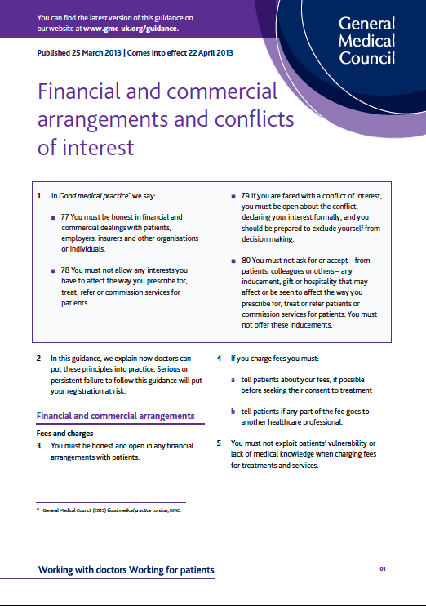
Guidance for Doctors
http://www.gmc-uk.org/guidance/ethical_guidance/21161.asp
Notes:
Why is it a problem – risk of affecting patient care

Slide 9
Guidance for doctors
“Conflicts of interest*
10 Trust between you and your patients is essential to maintaining effective professional relationships, and your conduct must justify your patients’ trust in you and the public’s trust in the profession. Trust may be damaged if your interests affect, or are seen to affect, your professional judgement. Conflicts of interest may arise in a range of situations. They are not confined to financial interests, and may also include other personal interests.
11 Conflicts of interest are not always avoidable, and whether a particular conflict creates a serious concern will depend on the circumstances and what steps have been taken to mitigate the risks, for example, by following established procedures for declaring and managing a conflict.
12 You should:
a use your professional judgement to identify when conflicts of interest arise
b avoid conflicts of interest wherever possible
c declare any conflict to anyone affected, formally and as early as possible, in line with the policies of your employer or the organisation contracting your services
d get advice about the implications of any potential conflict of interest
e make sure that the conflict does not affect your decisions about patient care.
13 If you are in doubt about whether there is a conflict of interest, act as though there is.”
* GMC Explanatory Guidance Financial and commercial arrangements and conflicts of interest April 2013
Notes:
Why is it a problem – PATIENT TRUST!!
Part of broader issue of transparency

Slide 10
Industry and junior doctors
Education and training
Research and academia
Journals and publications
Gifts and inducements
Healthcare-led incentives
Commissioning
Financial interests in companies
Advisory- consultancy services
NOW
FUTURE
Notes:
Might wonder how you as a junior doctor has any interaction with industry and whether there is opportunity for competing interests to arise.
Give examples
Both now and consider the case in the future

Slide 11
Interaction with industry: Questions to consider
Is patient care affected?
Could patient care be perceived to be affected?
Could this impact the perceived independence of my opinion / research?
Could I defend this interaction?
How might this impact me in 5/ 10/ 15 years time?

Slide 12
Where to declare?
Clinical notes & to patients!
Trust/ CCG/ Local practice Register
Appraisal or e-Portfolio
Reflective practice

Slide 13
Future?
National publically accessible registers in other countries
US sunshine act¹
Netherlands Transparency Register²
ABPI register in UK³ disclosing payments to individuals clinicians
Future?
? National register
? Declare on the GMC register
¹ http://www.ama-assn.org/ama/pub/advocacy/topics/sunshine-act-and-physician-financial-transparency-reports.pag
² http://www.transparantieregister.nl/en-GB/Over-het-Transparantieregister
³ http://www.abpi.org.uk/our-work/disclosure/Pages/disclosure.aspx

Slide 14
Poll
Doctors should declare their interests on a national database, which is publicity available?
Agree
Disagree
Unsure

Slide 15
Poll results:

Slide 16
Repeat poll
Do you think you have any competing interests or interactions with industry that you might need to declare?
Yes
No
Unsure

Slide 17
Poll results:

Slide 18
NEJM poll on COIs
NEJM invited readers to put themselves in the role of editor and help decide about the suitability of three hypothetical potential authors of review articles for the Journal – each of whom had potential COIs
See the results of the poll here: http://www.nejm.org/doi/story/10.1056/feature.2015.05.27.41?query=featured_home&#discussion

Slide 19
Key objectives
This webinar discussed:
What is a competing interest?
Why should junior doctors know about this?
How can junior doctors promote transparency?
How should junior doctors declare their competing interests?
How to make use of opportunities and still future-proof your career?

Slide 20
Thank you and any questions
Join us:
Twitter: @agents4c #agents4c
Facebook: www.facebook.com/groups/agents4c

